Slide 1

AIO HIGH ACHIEVERS CAMP · SESSION 3
GREEDY AND THE WATER LEVEL
Notes:
第 3 次课：三道题画出来是同一幅图，一排柱子和一条水平线。两道题削掉线上方的峰（cut the peaks），一道题填平线下方的谷（fill the valleys）。其中两道用 Binary Search 找这条线，第三道枚举每一个值。

Slide 2
LESSON 3 · 2 HOURS
TODAY'S PLAN
Time | Content | Technique
0:00–0:15 | Greedy, exchange arguments, the water level | Greedy
0:15–0:50 | 2026 P6 Mundane Square | Greedy + Binary Search
0:50–1:10 | 2023 P5 Wheeling and Dealing | Greedy + try every level
1:10–1:30 | 2026 P5 Prime Minister | Binary search on the answer
1:30–1:55 | Live coding: Prime Minister | Full program + samples
1:55–2:00 | Recap and homework | —
Notes:
Wheeling and Dealing 的完整解法只需要按花费分桶（每 100 个花费一块），全是数组和循环。课上讲思路、手算和分桶的代码。

Slide 3
THE FOUR CORE TECHNIQUES · GREEDY
GUESS A RULE, THEN PROVE IT IS SAFE
1. Guess the rule from small cases.
2. Take any best answer that breaks the rule.
3. Swap one piece so it follows the rule. If the answer is no worse, the rule is safe: an exchange argument.
Serve the tallest column first · buy each rival's cheapest voters · top up the poorest person.
Notes:
没有第 3 步的 Greedy 规则只是猜测。AIO 的题通常猜规则很容易，证明才是真正的工作。整节课把第 3 步留在黑板上。

Slide 4
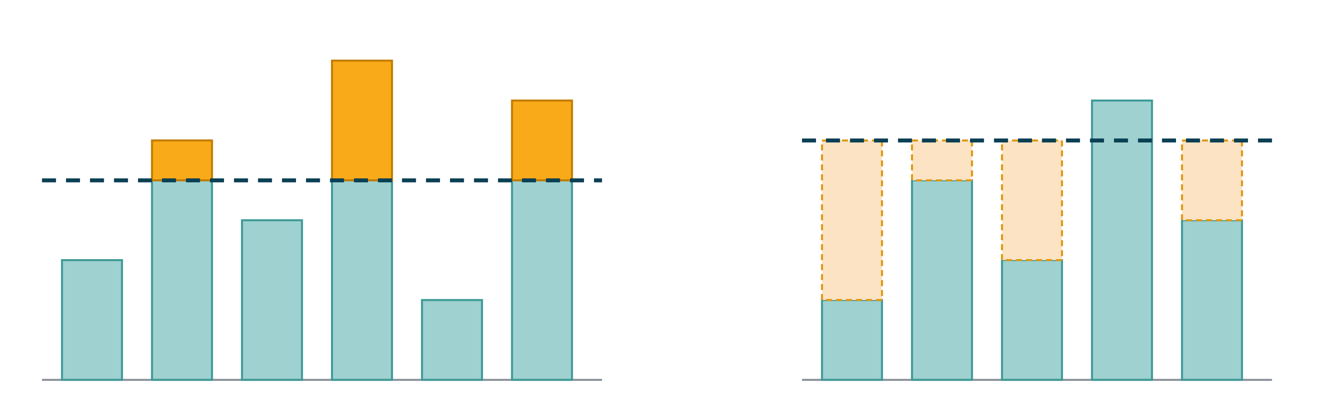
TODAY'S PICTURE
COLUMNS AND A WATER LEVEL
Cut the peaks above the line
Mundane Square · Wheeling and Dealing
Fill the valleys up to the line
Prime Minister
Notes:
整节课都把这幅图留在黑板上。每道题都问：柱子是什么？这条线代表什么？
参考：Mundane Square：柱子 = 每列还缺的数量，线 = λ（削峰）；Wheeling and Dealing：柱子 = 每个对手的票数，线 = k − 1（削峰）；Prime Minister：柱子 = 右半边每个人的财富，线 = x（填谷）。

Slide 5

2026 AIO PROBLEM 6
MUNDANE SQUARE
Build a grid with given row and column sums, every cell between 0 and K.
Greedy · main
Binary Search · support
Prefix Sum
Two Pointers
Notes:
约 35 分钟。这是本次课的核心题，另外两道都拿来和它比较。

Slide 6
MUNDANE SQUARE
THE PROBLEM
Build an $N×N$ grid of integers in $\left[0,K\right]$ whose row $i$ sums to $R_{i}$ and column $j$ sums to $C_{j}$. Print YES and the grid, or NO.
$N≤1000$, $K,R_{i},C_{j}≤{10}^{9}$
Think of it as shipping: row $i$ sends $R_{i}$ units, column $j$ needs $C_{j}$ units, and each (row, column) pair carries at most $K$.
Notes:
在黑板上写样例 1：K = 4，R = 6 8 3，C = 5 5 7。

Slide 7
MUNDANE SQUARE · EASY NOs FIRST
NECESSARY, BUT NOT ENOUGH
$∑R=∑C$. Sample 3: $7+0+3=10$ but $6+2+3=11$ → NO.
Every $R_{i},C_{j}≤N⋅K$. Sample 4: $K=1$, $N=4$, $R_{2}=5>4$ → NO.
In general this is a max-flow problem, but $N=1000$ means ${10}^{6}$ edges with capacities up to ${10}^{9}$. Too heavy, and outside AIO.
We need a greedy rule.
Notes:
提到 max-flow 只是让较强的学生知道这题在理论上属于哪一类，课上不讲。

Slide 8
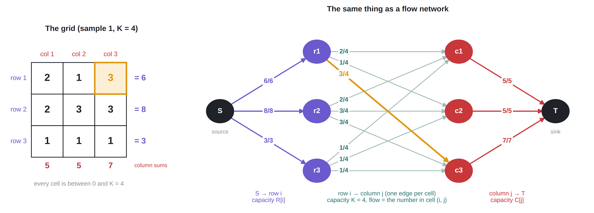
MUNDANE SQUARE · ANOTHER VIEW
THE GRID IS A FLOW NETWORK
A grid exists $⇔$ max flow from $S$ to $T$ $=∑R=∑C$ (17 here): every $S$-edge and $T$-edge full.
Open the Flow Lab ↗
Notes:
换个角度看这道题：它其实是一个 max flow（最大流）问题。
建图：源点 S → 每一行 r_i，容量 R[i]（这一行要发出的总量）；每一行 r_i → 每一列 c_j，一条边对应一个格子，容量 K（格子里的数在 0 到 K 之间）；每一列 c_j → 汇点 T，容量 C[j]（这一列要收到的总量）。
中间边上的流量就是格子里的数：左边格子 (1, 3) = 3，对应右边 r1 → c3 的流量 3（橙色）。
结论：存在合法网格 ⇔ 从 S 到 T 的最大流 = ΣR = ΣC（样例 1 是 17），也就是所有 S 出边和 T 入边都被流满。
为什么不直接写 max flow：N² 条边、容量到 10⁹，超出 AIO 的范围也太慢。我们用 greedy + 水位线二分，算出的正是这样一个满流。

Slide 9
MUNDANE SQUARE · KEY OBSERVATION
FILL ROW BY ROW: TALLEST COLUMN FIRST
Give each row's units to the columns that still need the most, at most $K$ per cell.
Why: a column that still needs a lot is the hardest to satisfy. Every later row can give it at most $K$, and rows are running out. Columns that need little are easy to top up later.
Notes:
这是 Greedy 三步法的第 1 步：猜规则。下一页是第 3 步：exchange argument。

Slide 10
MUNDANE SQUARE · WHY IT IS SAFE
THE EXCHANGE ARGUMENT
Suppose a valid grid gives this row's unit to column $j$ (needs less) instead of column $i$ (needs more, not yet at $K$).
Column $i$ needs more, so some later row $r$ gave $i$ more than $j$.
Swap: this row moves one unit $j→i$; row $r$ moves one unit $i→j$. All row and column sums stay the same.
So if any answer exists, the greedy finds one.
Notes:
在右侧画一个 2×2 的子网格：当前行和第 r 行、第 i 列和第 j 列，四个格子分别标 +1/−1。K = 1 时这就是 Gale–Ryser 定理背后的构造。这份解答也用 max-flow 暴力对拍验证过。

Slide 11
MUNDANE SQUARE · MAKING IT FAST
WATER-FILLING: BINARY SEARCH THE LEVEL
One unit at a time is too slow ($R_{i}$ up to ${10}^{9}$). Treat ${rem}_{j}$ (what column $j$ still needs) as column heights and cut everything above a level $λ$:
$$x_{j}=min\left(K,max\left(0,{rem}_{j}−λ\right)\right)$$
Lower $λ$ → more units sent: monotone. Binary search the smallest $λ$ with $\sum_{j}^{​}{x_{j}}≤R_{i}$. Hand the few leftover units, one each, to columns sitting exactly at $λ$ that are still below $K$.
Notes:
指回水位线图的左半边：这就是"削峰"。上限 K 表示每一格最多削 K。

Slide 12
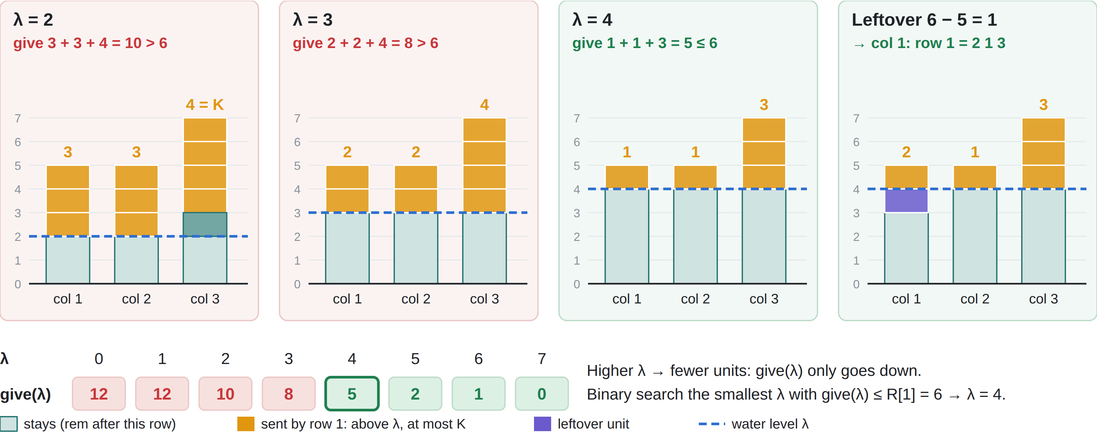
MUNDANE SQUARE · WATER-FILLING, PICTURED
SAMPLE 1, ROW 1: $K=4$, SEND 6
Notes:
用样例 1 第 1 行演示水位线算法（K = 4，R[1] = 6，rem = 5 5 7）。
柱子高度 = 每一列还缺多少（rem）。蓝色虚线是水位 λ：线以上的部分（橙色）这一行发出去，但每列最多 K。
λ = 2：发 3 + 3 + 4 = 10，太多；第 3 列线以上有 5，但最多发 K = 4，所以有 1 格留在线以上（深色）。λ = 3：发 8，还是太多。λ = 4：发 5 ≤ 6，这是满足条件的最小 λ。
零头 6 − 5 = 1：给一个正好在水位线上、而且还没发满 K 的列。这里选第 1 列（紫色），第 1 行最终 = 2 1 3，rem 变成 3 4 4。
下方一行是 give(λ) 的值：λ 越大发得越少，单调递减，所以可以二分 λ，找第一个 give(λ) ≤ R[i] 的位置。
和上一页公式 x[j] = min(K, max(0, rem[j] − λ)) 一一对应；下一步就是第 2、3 行（见手算页）。

Slide 13
MUNDANE SQUARE · ALGORITHM
FOR EACH ROW
If $∑R≠∑C$: NO. Start with ${rem}_{j}=C_{j}$.
Capacity check: $\sum_{j}^{​}{min}\left(K,{rem}_{j}\right)$ is the most this row can send. If it is less than $R_{i}$: NO.
Binary search the smallest $λ$ with $give\left(λ\right)≤R_{i}$.
Fill $x_{j}$; hand out the leftover; subtract from $rem$.
At the end every ${rem}_{j}$ must be 0, else NO.
Notes:
第 2 步常被误解：capacity 是这一行最多能发出多少（每格 ≤ K，也不超过该列还缺的数量）。如果连这个都小于 R[i]，这一行就填不满；如果 ≥ R[i]，说明有余量，由 λ 决定少发多少。

Slide 14
MUNDANE SQUARE · WORK IT BY HAND
SAMPLE 1, ROW 1 (SEND 6)
$K=4$ $R$ = 6 8 3 $C$ = 5 5 7 → $rem$ = 5 5 7
$$λ$$ | col 1 | col 2 | col 3 | total | $≤6$?
3
4
2
2
4
8
no
1
1
3
5
yes
4
1
1
2
1
3
$λ$ = ___ leftover = ___ → goes to column ___ row 1 = ___ ___ ___
new $rem$ = ___ ___ ___
3
4
4
Notes:
放映时按键（或点击）逐步显示红色答案：①λ = 3 行 ②λ = 4 行 ③λ ④零头和给哪一列 ⑤第 1 行 ⑥新的 rem。先让学生在纸上填，再一下一下揭晓。
答案：λ = 3：2 2 4 = 8 > 6。λ = 4：1 1 3 = 5 ≤ 6。所以 λ = 4，零头 leftover = 1，给第 1 列（5 − 1 = 4 = λ，且 1 < K）。第 1 行 = 2 1 3，rem = 3 4 4。
第 2 行（发 8）：λ = 0 得 11，λ = 1 得 2 3 3 = 8 → 第 2 行 = 2 3 3，rem = 1 1 1。
第 3 行（发 3）：1 1 1。输出 YES / 2 1 3 / 2 3 3 / 1 1 1（和样例输出不同，但题目接受任何合法的矩阵）。

Slide 15
MUNDANE SQUARE · CORE CODE
$give\left(λ\right)$ AND THE SEARCH
// units this row sends at level lam
long long give(long long lam){
long long sum = 0;
for (int j = 1; j <= n; j ++)
sum += min(K, max(0LL, rem[j] - lam));
return sum;
}
if (give(0) < R[i]){
cout << "NO" << endl;
return 0;
}
// first lam with give <= R[i] → l
while (l <= r){
long long mid = (l + r) / 2;
if (give(mid) <= R[i])
r = mid - 1;
else
l = mid + 1;
}
Notes:
l 从 0 开始，r 取 rem[j] 的最大值。N 行 × 约 30 次二分 × N 列 ≈ 3×10^7，没问题。最多要输出 10^6 个数：每行结束时用一次 endl，不要每个数都 endl。

Slide 16
MUNDANE SQUARE · CORE CODE 2
HANDING OUT THE LEFTOVER
Why it always fits
long long left = R[i] - give(lam);
// left = leftover, fewer than one layer
for (int j = 1; j <= n; j ++){
long long v = min(K, max(0LL, rem[j] - lam));
// on the line and still room? one more
if (left > 0 && v < K && rem[j] - v == lam && lam > 0){
v ++;
left --;
}
a[i][j] = v;
rem[j] -= v; // column j now needs less
}
$λ$ is the smallest level with $give\left(λ\right)≤R_{i}$, so one level lower sends too much: $give\left(λ−1\right)>R_{i}$.
Lowering the line from $λ$ to $λ−1$ adds exactly 1 to each column that sits on the line and is below $K$. So $give\left(λ−1\right)−give\left(λ\right)$ = number of such columns.
$left=R_{i}−give\left(λ\right)<give\left(λ−1\right)−give\left(λ\right)$. Fewer leftover units than such columns: one each is enough.
Sample 1, row 1: $give\left(3\right)=8>6$, $give\left(4\right)=5$, $left=1$. Columns on the line below $K$: 3 (all of them). $1<3$ ✓
v < K: the cell still has room. rem[j] − v == lam: after the cut, the column sits exactly on the line. lam > 0: just a guard (at $λ=0$ there is never a leftover).
Notes:
这一页回答两个问题：零头为什么一定分得完；分零头的代码怎么写。
1. 为什么分得完：λ 是满足 give(λ) ≤ R[i] 的最小值，所以 give(λ − 1) > R[i]。把水位线从 λ 降到 λ − 1，只有"正好顶在线上、还没到 K"的列会多发 1 个（线以下的列不受影响；已经发满 K 的列也不能再多），所以 give(λ − 1) − give(λ) 正好等于这种列的个数。零头 left = R[i] − give(λ) < give(λ − 1) − give(λ)，即零头个数少于这种列的个数，每列给 1 个就够了，而且每列最多多 1 个，不会超过 K。
样例 1 第 1 行：give(3) = 8 > 6，give(4) = 5，零头 1；三列都正好在线上（rem − v = 4）且都没到 K，有 3 列可选，1 < 3。
2. 代码逐行讲（给编码不熟的同学）：left 是零头；循环里先按公式算 v（削掉线以上的部分）；然后检查三件事：还有零头吗（left > 0）？这一格还没满吗（v < K）？削完后这一列正好在线上吗（rem[j] − v == lam）？三个都满足就多给 1 个：v ++，left --。最后把 v 写进答案 a[i][j]，并从 rem[j] 里减掉。
lam > 0 只是保险：λ = 0 时 give(0) ≥ R[i] 且 give(0) ≤ R[i]，零头一定是 0。完整程序里循环后还有 if (left > 0) 输出 NO，按上面的证明它永远不会触发，也只是保险。

Slide 17
MUNDANE SQUARE · SCORING ROUTE
SUBTASKS AND COMMON MISTAKES
Subtask ladder
Common mistakes
$R_{i}=1$, $K$ huge: one unit per row, any column still short
$K$ huge: fill in order; $∑R=∑C$ is enough
$K=1$: 0/1 grid, tallest columns first
Small values: greedy one unit at a time
Full: water-filling + binary search
Forgetting $∑R=∑C$
Filling columns in index order when $K$ is small
Serving the column that needs the least
One unit at a time on the full data
Notes:
提问：如果每个格子有自己的上限 K[i][j]，Greedy 还成立吗？
答案：不一定，这时需要真正的 max-flow。

Slide 18
MUNDANE SQUARE · COMPLEXITY RECAP
ONE LEVEL PER ROW, NOT ONE UNIT AT A TIME
Approach | Time | Operations
General max-flow on the $N^{2}$ row–column edges | far too slow | outside AIO ✗
Greedy, one unit at a time (tallest column first) | $$O\left(\left(∑R\right)logN\right)$$ | up to ${10}^{15}$ ✗
Greedy, whole row at once: Binary Search the water level $λ$ | $$O\left(N^{2}logC\right)$$ | $≈3×{10}^{7}$ ✓
The greedy rule makes the problem solvable; Binary Search on the level makes each row cost $O\left(NlogC\right)$ instead of $R_{i}$ steps.
Notes:
复杂度回顾（N ≤ 1000，K, R[i], C[j] ≤ 10⁹）：
理论上这是 max-flow 问题，但 N² 条边、容量到 10⁹，远超 AIO 的范围。
Greedy 规则（每次给最缺的列）是对的，但一个单位一个单位地发，总量 ΣR 可达 10¹⁵ 级别，太慢。
关键：一整行一次发完——水位线 λ 越低发出越多，单调，所以对每一行二分 λ（约 30 次），每次 O(N)：总共 O(N² log C) ≈ 3×10⁷。这里 C = max C[j] ≤ 10⁹：rem[j] ≤ C[j]，所以 λ 的二分范围不超过 C，约 log₂10⁹ ≈ 30 轮。
输出：最多 10⁶ 个数（约 10 MB）。实测普通 cout（每行一个 endl）约 0.09 秒，1 秒时限内不需要优化。但可以借机提醒学生养成习惯：输出超过约 10⁵ 个数时，在 main 开头加 ios::sync_with_stdio(false); cin.tie(0);，换行用 "\n" 而不是 endl（endl 每次都会刷新缓冲区）；加了这一行后不要再混用 cin/cout 和 scanf/printf。配套代码已经这样写。
提问：Greedy 和 Binary Search 各自解决了什么？答案：Greedy 决定"给谁"，Binary Search 决定"一行给到哪个水位"。

Slide 19
2023 AIO PROBLEM 5
WHEELING AND DEALING
Same picture: cut the tallest rivals down to a level.
Greedy · main
Prefix Sum · support (bucket sums)
Binary Search
Two Pointers
Notes:
约 20 分钟。注意这里不用 Binary Search：花费关于水位线不单调，这是和 Mundane Square 最主要的区别。

Slide 20
WHEELING AND DEALING
THE PROBLEM
$N$ candidates, $M$ voters. Voter $i$ plans to vote for $V_{i}$; paying $P_{i}$ makes them vote for anyone you like.
Find the minimum cost so candidate 1 gets strictly more votes than every other candidate.
$N,M≤{10}^{5}$, $P_{i}≤10000$
First simplification: a bought voter should always switch to candidate 1. That takes a vote from a rival and adds one to us.
Notes:
所以唯一的问题是：买哪些选民？
参考：让被买的选民都改投 1 号（对手少一票、1 号多一票），一定不比改投别人差。

Slide 21
WHEELING AND DEALING · KEY OBSERVATION
AIM FOR AT LEAST $k$ VOTES
The water level is $k−1$. Every rival must end with at most $k−1$ votes; we need at least $k$:
a rival with $c$ votes loses at least $c−k+1$: buy their cheapest voters
Still short of $k$? Top up with the cheapest voters left anywhere.
Forced buys may already give us more than $k$ votes. That is fine: we still win, and no top-up is needed.
Try every $k$ and keep the cheapest total.
Notes:
Exchange argument：如果买了某个对手较贵的选民，却没买他更便宜的选民，换成便宜的，票数结果相同，花费更少。
注意 k 的含义：k 是 1 号票数的下限（至少 k 票），不是最终的确切票数。每个对手至多 k − 1 票、1 号至少 k 票，1 号就一定赢。被迫购买之后 1 号可能已经超过 k 票（手算页 k = 1 时有 7 票），这个方案仍然合法，只是不用再补买。为什么枚举所有 k 取最小就是答案：每个 k 给出的都是合法方案；而最优方案如果最终有 F 票、对手都 ≤ F − 1，它在 k = F 这一轮满足约束，greedy 的花费不会比它高。

Slide 22
WHEELING AND DEALING · WORK IT BY HAND
A SMALL EXAMPLE
Candidate 1: 1 vote Candidate 2: 4 votes, costs 1 2 5 9 Candidate 3: 2 votes, costs 3 3
$$k$$ | Forced buys | Our votes | Top-up | Total
1
2
3
4
5
23
7
0
23
11
5
0
11
3
3
0
3
1
2
5
6
0
1
9
9
Notes:
放映时按键（或点击）逐步显示红色答案：①–⑤ k = 1 到 5 各一行。先让学生在纸上填，再一下一下揭晓。
答案（自编例子，已用解答程序验证）：
k = 1：两个对手都削到 0：1+2+5+9 + 3+3 = 23，我方 7 票。
k = 2：2 号削到 1（1+2+5），3 号削到 1（3）= 11，我方 5 票。
k = 3：2 号削到 2（1+2）= 3，我方 3 票。最优。
k = 4：2 号削到 3（1），我方 2 票，再补买剩下最便宜的 2 个（2+3）= 6。
k = 5：不用削，补买最便宜的 4 个（1+2+3+3）= 9。
花费依次是 23、11、3、6、9：两头都贵，关于 k 不单调，所以不能二分，只能枚举每个 k。

Slide 23
COMPARE THE PAIR
SAME PICTURE, DIFFERENT SEARCH
 | Wheeling and Dealing (P5) | Mundane Square (P6)
Goal | Minimum cost | Does a grid exist? Build it
Columns | Each rival's votes | What each column still needs
The level | Try every $k$: cost is not monotone | Binary search $λ$: total is monotone
Greedy choice | Each rival's cheapest voters | Columns that need the most
Tools | Sorting, cost buckets | Binary search, a scan
Notes:
提问：为什么 Mundane 可以二分水位线，而 Wheeling 不行？
答案：指着花费 23、11、3、6、9：Wheeling 的花费关于 k 不单调；Mundane 中"这一行发出的总量"关于 λ 单调不增。

Slide 24
WHEELING AND DEALING · MAKING IT FAST
TWO PARTS, TWO SPEED-UPS
Try every target $k$ ($M$ of them). Each $k$ has two parts:
① Forced buys
② Top-up
Cut every rival with $≥k$ votes down to $k−1$ by buying his cheapest voters.
Still short of $k$? Buy the $t$ cheapest voters left in the pool.
Every $k$ from scratch: scan or sort the whole pool, $O\left(M\right)$ for one $k$ → $O\left(M^{2}\right)≈{10}^{10}$ ✗
Every $k$ from scratch: up to $M$ buys for one $k$, and $M$ values of $k$ → $O\left(M^{2}\right)≈{10}^{10}$ ✗
Better: group the pool by cost (costs $≤10000$) in blocks of 100. Skip whole blocks, then finish inside one block: $≈200$ steps per $k$ → $O\left(M\sqrt{10000}\right)≈2×{10}^{7}$ ✓
Better: sweep $k$ from high to low. When $k$ drops by 1, each rival needs just one more buy, and buys are never undone. All $k$ together: at most $M$ buys → $O\left(M\right)$ ✓
Total: sort once $O\left(MlogM\right)+O\left(M\right)+O\left(M\sqrt{10000}\right)$. Fast enough for $M={10}^{5}$.
Notes:
这一页讲清楚整个算法的开销：枚举每个目标 k（最多 M 个），每个 k 有两部分工作。
① 强制购买（forced buys）：把每个票数 ≥ k 的对手削到 k − 1，买他最便宜的选民。如果每个 k 都从头算，一个 k 最多要买 M 个，M 个 k 一共 O(M²) ≈ 10¹⁰，太慢。改进：k 从大到小扫。k 每减 1，每个需要削的对手只多买 1 个（他下一个最便宜的），之前买的不会退回，所以所有 k 加起来最多买 M 次，O(M)。
② 补买（top-up）：强制购买后 1 号还不到 k 票，就从剩下的池子里买最便宜的 t 个。如果每个 k 都把池子扫一遍或排序，一个 k 是 O(M)，总共 O(M²) ≈ 10¹⁰，也太慢。改进：花费 ≤ 10 000，把池子按花费分组，每 100 个花费一块，记下每块的人数和总和；求最便宜的 t 个时先整块跳，再在一块里逐个花费拿，每个 k 约 200 步，总共 O(M · √10 000) ≈ 2 × 10⁷。
总复杂度：开始时排序 O(M log M)，加上两部分，M = 100 000 时 1 秒内轻松通过。后面两页分别讲这两部分代码的写法。
Subtask 1–2（每个花费都是 $1）只需要计数；subtask 3（N, M ≤ 100）每个 k 从头算就够了。和 Codeforces 1019A "Elections" 是同一类题。

Slide 25
WHEELING AND DEALING · CORE CODE 1
WRITING THE SWEEP
Sort voters by (candidate, cost). Rival $j$'s voters sit together, cheapest first: a[st[j]] … a[st[j] + votes[j] - 1]. taken[j] counts how many we have bought from him, so his next cheapest is a[st[j] + taken[j]].
Group rivals by vote count: list head[c] holds the rivals with exactly $c$ votes.
Loop $k$ from $M$ down to $max\left(c_{1},1\right)$. Rivals in head[k] join the active list act and stay there for all smaller $k$.
For each active rival $j$, buy while taken[j] < votes[j] - (k - 1): add the cost to fc, fn ++, remove that voter from the pool.
We now have have = c1 + fn votes. If have < k, add cheapest(k - have) (skip $k$ if the pool is too small). Keep the smallest cost.
Trace on the hand example (C1: 1 vote, C2: 1 2 5 9, C3: 3 3):
$$k$$ | new forced buys (costs) | fc | have | top-up ($t→$ cost) | cost
7 | — | 0 | 1 | 6 → 23 | 23
6 | — | 0 | 1 | 5 → 14 | 14
5 | — | 0 | 1 | 4 → 9 | 9
4 | C2: 1 | 1 | 2 | 2 → 5 | 6
3 | C2: 2 | 3 | 3 | — | 3
2 | C2: 5, C3: 3 | 11 | 5 | — | 11
1 | C2: 9, C3: 3 | 23 | 7 | — | 23
Why O(M): act and taken[j] only grow, so each voter is bought at most once.
Notes:
这一页讲 sweep 的写法，不逐行看代码，按步骤讲。
① 选民按（候选人, 花费）排序：对手 j 的选民挨在一起、从便宜到贵，是 a[st[j]] 到 a[st[j] + votes[j] − 1]。taken[j] 记从 j 那里已经买了几个，所以他下一个最便宜的就是 a[st[j] + taken[j]]，不需要再找。
② 对手按票数分组：head[c] 是票数恰好为 c 的对手列表（用 nx[] 串成链表）。
③ k 从 M 往下扫到 max(c1, 1)。到 k 时，票数恰好为 k 的对手开始需要被削，把他们加入 act；k 再变小他们仍然要削，所以 act 只增不减。
④ 对 act 里每个对手 j：他要剩 k − 1 票，就要被买走 votes[j] − (k − 1) 个；已经买了 taken[j] 个，不够就继续买下一个最便宜的，累加强制花费 fc、强制票数 fn，并把这个选民从池子里删掉。
⑤ 1 号现在有 have = c1 + fn 票。不够 k 就用 cheapest(k − have) 从池子里补最便宜的（池子人数不够就跳过这个 k），更新最小花费。
右边的表是程序在手算例子上实际算出的中间值（k 从 7 到 1）：k = 7、6、5 没有对手要削，全靠补买；k = 4 时 C2 加入，买他最便宜的 1，补买时池子里只剩 2、5、9、3、3，最便宜的 2 个是 2 + 3；k = 3 花费 3，是最小值；k = 2 时 C3 也加入。答案 3。
为什么是 O(M)：taken[j] 只增不减，每个选民最多被强制买一次；act 的遍历总次数是各对手票数之和 ≤ M。

Slide 26
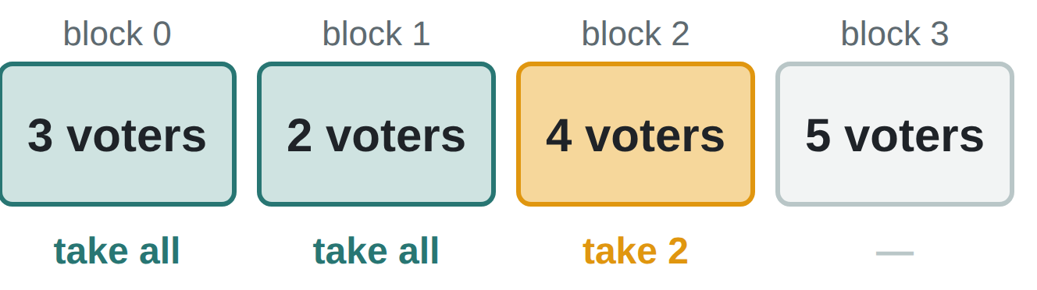
WHEELING AND DEALING · CORE CODE 2
WRITING THE COST BUCKETS
Three arrays. cnt[c] = voters in the pool with cost $c$. Block $b$ holds costs $100b,…,100b+99$: bcnt[b] = how many voters, bsum[b] = their total cost.
Add or remove a voter of cost $c$: change cnt[c], bcnt[c / 100] and bsum[c / 100] together. Forced buys remove; at the start every voter not voting for 1 is added.
cheapest(t), part 1: walk the blocks from $b=0$. While block $b$ has fewer than $t$ voters, take it whole: t -= bcnt[b], sum += bsum[b].
cheapest(t), part 2: block $b$ has enough. Walk its costs from $100b$ upwards; at each cost take min(cnt[c], t) voters until $t=0$.
Example, $t=7$: block 0 has 3, block 1 has 2 → take both (5 so far). Block 2 has $4≥2$ → go inside it and take its 2 cheapest.
Why $≈200$ steps: at most 101 blocks, then at most 100 costs inside one block. $10000=100×100$, so blocks of 100 balance the two walks.
Notes:
这一页讲按花费分组（分桶）的写法。
① 三个数组：cnt[c] 是池子里花费为 c 的选民人数；第 b 块包含花费 100b 到 100b + 99，bcnt[b] 是这一块的人数，bsum[b] 是这一块的花费总和。
② 加入或删除一个花费为 c 的选民：三个数组一起改，cnt[c]、bcnt[c / 100]、bsum[c / 100]。一开始把所有不投 1 号的选民加入；强制购买时删除。
③ cheapest(t) 第一步：从第 0 块往后走，这一块的人数还不够 t，就整块拿走（t 减去人数，sum 加上总和）。
④ cheapest(t) 第二步：走到某一块人数够了，就进入这一块，从花费 100b 开始往上，每个花费拿 min(cnt[c], t) 个，直到 t = 0。
例子：块里的人数依次是 3、2、4、5，t = 7：拿走第 0 块（3 个）和第 1 块（2 个），还差 2 个；第 2 块有 4 个 ≥ 2，进入第 2 块拿最便宜的 2 个。
为什么大约 200 步：最多走 101 块，再在一块里最多走 100 个花费。可以问学生：为什么块的大小取 100？（10 000 = 100 × 100，块数和块内长度都是 100，两段加起来最少。）

Slide 27
WHEELING AND DEALING · COMPLEXITY RECAP
FROM $O\left(2^{M}\right)$ TO $O\left(M\sqrt{10000}\right)$
Approach | Time | Operations
Try every set of voters to buy | $$O\left(2^{M}\right)$$ | ✗
Try every $k$, recompute forced buys and the top-up from scratch | $$O\left(M^{2}\right)$$ | ${10}^{10}$ ✗
Try every $k$, sweep $k$ downwards + cost buckets for the cheapest $t$ | $$O\left(M\sqrt{10000}\right)$$ | $≈2×{10}^{7}$ ✓
Greedy fixes what to buy for each $k$; sweeping $k$ downwards means each voter is bought at most once.
Notes:
复杂度回顾（N, M ≤ 100 000，P[i] ≤ 10 000）：
暴力：枚举买哪些选民，2^M。
固定目标 k（1 号至少 k 票、每个对手至多 k − 1 票）之后，Greedy 告诉我们买哪些：每个对手削到 k − 1 票（买他最便宜的），不够再补买全局最便宜的。逐个 k 从头算是 O(M²) ≈ 10¹⁰。
关键：k 从大到小扫，被迫购买只增不减，每个选民最多被买一次；"剩下最便宜的 t 个"按花费分桶（每 100 个花费一块），每次最多约 200 步。总共 O(M · √10 000)。
注意：花费关于 k 不单调，所以不能二分，只能扫描每个 k。

Slide 28
2026 AIO PROBLEM 5
PRIME MINISTER
Flip the picture: fill the valleys up to a level.
Binary Search · main
Greedy · support
Prefix Sum
Two Pointers
Notes:
约 20 分钟，之后这道题就是现场编码题。

Slide 29
PRIME MINISTER
THE PROBLEM
$N$ people ($N$ odd) have wealth $A_{1}≤…≤A_{N}$. Hand out $K$ dollars (non-negative whole amounts each).
Make the median wealth as large as possible.
$N≤2×{10}^{5}$, $K,A_{i}≤{10}^{9}$
Notes:
在黑板上写样例 1：N = 5，K = 4，A = 1 2 5 6 9。答案 7。

Slide 30
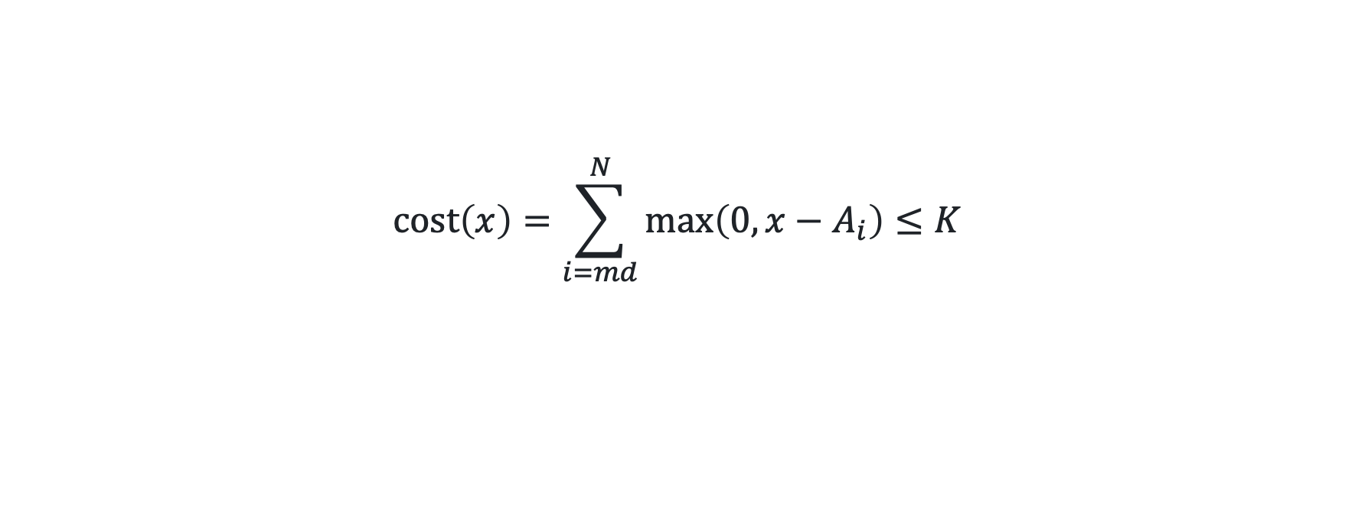
PRIME MINISTER · KEY OBSERVATION
CAN THE MEDIAN REACH $x$?
1. Median $≥x⇔$ at least $\left(N+1\right)/2$ people have $≥x$.
2. Cheapest way (Greedy): raise the richest $\left(N+1\right)/2$ people, $A_{md},…,A_{N}$ with $md=\left(N+1\right)/2$. Money for the left half never helps.
$$cost\left(x\right)=\sum_{i=md}^{N}{\max\left(0, x−A_{i}\right)}≤K$$
3. Bigger $x$ costs more: monotone → binary search on the answer, last $x$ that passes.
Notes:
搜索范围：[A[md], A[md] + K]。
提问：为什么 A[md] + K 是安全的上界？
答案：中位数要 ≥ x，至少要让 A[md] 这个人达到 x；就算把 K 全给他，也只能到 A[md] + K。

Slide 31
PRIME MINISTER · WORK IT BY HAND
SAMPLE 1: $K=4$, $A$ = 1 2 5 6 9
3
5
6
9
5
9
$md$ = ___ right half = ___ ___ ___ search range = [___, ___]
$$x$$ | top up 5 | top up 6 | top up 9 | cost | $≤4$?
6
7
8
1
0
0
1
yes
2
1
0
3
yes
3
2
0
5
no
7
Answer = ___
Notes:
放映时按键（或点击）逐步显示红色答案：①md ②右半边 ③搜索范围 ④–⑥ x = 6、7、8 各一行 ⑦答案。先让学生在纸上填，再一下一下揭晓。
答案：md = 3，右半边 5 6 9，搜索范围 [5, 9]。
x = 6：要补 1 0 0 → 1，可以。x = 7：2 1 0 → 3，可以。x = 8：3 2 0 → 5，不行。答案 7（找最后一个可行值 → 输出 r）。

Slide 32
COMPARE ALL THREE
THREE USES OF THE WATER LEVEL
 | Prime Minister | Mundane Square | Wheeling and Dealing
Columns | Right half's wealth | What each column needs | Each rival's votes
Action | Fill below $x$ | Cut above $λ$, $≤K$ per cell | Cut above $k−1$
Find the level by | Binary search (last $x$) | Binary search (first $λ$) | Trying every $k$
Goal | Optimise | Exists? Build it | Optimise
Notes:
和全班一起填这张表，一次填一列。
参考答案就是表中内容：柱子分别是右半边的财富 / 每列还缺的数量 / 每个对手的票数；动作分别是填谷 / 削峰（每格 ≤ K）/ 削峰；找水位线的方法分别是二分（最后一个 x）/ 二分（第一个 λ）/ 枚举每个 k；目标分别是最优化 / 判断有没有解并构造 / 最优化。

Slide 33
FILL VS CUT IN CODE
ONE MIN, ONE MAX APART
Prime Minister: fill
Mundane Square: cut
bool check(long long x){
long long cost = 0;
for (int i = md; i <= n; i ++)
if (a[i] < x){
cost += x - a[i];
if (cost > K)
return false;
}
return true;
}
long long give(long long lam){
long long sum = 0;
for (int j = 1; j <= n; j ++)
sum += min(K,
max(0LL, rem[j] - lam));
return sum;
}
Notes:
提问：两个函数分别朝哪个方向单调？分别找第一个还是最后一个可行值？
答案：Prime Minister：x 越大 cost 越大，找最后一个可行的 x（→ r）。Mundane：λ 越小 give 越大，找第一个满足 give(λ) ≤ R[i] 的 λ（→ l）。

Slide 34
PRIME MINISTER · COMPLEXITY RECAP
FROM $O\left(KlogN\right)$ TO $O\left(NlogK\right)$
Approach | Time | Operations
Give $1 at a time to the poorest of the right half | $$O\left(KlogN\right)$$ | $≈1.8×{10}^{10}$ ✗
Try every target $x$ from $A_{md}$ upwards | $$O\left(K⋅N\right)$$ | $2×{10}^{14}$ ✗
Binary Search on $x$ with an $O\left(N\right)$ check | $$O\left(NlogK\right)$$ | $≈6×{10}^{6}$ ✓
Only the right half matters (Greedy); "can the median reach $x$?" is monotone, so about 30 checks replace up to ${10}^{9}$ tries.
Notes:
复杂度回顾（N ≤ 200 000，K, A[i] ≤ 10⁹）：
模拟：每次把 $1 给右半边最穷的人，用堆 O(K log N)，K 可达 10⁹。
枚举目标 x：x 最多比 A[md] 大 K，每个 x 检查 O(N)，O(K·N)。
关键：Greedy 说明只需要把右半边补到 x；"中位数能否达到 x"关于 x 单调，二分约 30 次，每次 O(N)：O(N log K) ≈ 6×10⁶。

Slide 35
LIVE CODING · 25 MINUTES
WRITE PRIME MINISTER FROM SCRATCH
Read $N$, $K$ and $A_{1},…,A_{N}$ (long long); $md=\left(N+1\right)/2$
Write check(x): top up $A_{md},…,A_{N}$ to $x$, stop early once cost $>K$
Binary search $x$ in $\left[A_{md},A_{md}+K\right]$ for the last value that passes
Print r
Test the samples: expect 7, 6, 2
Finished early? Write the slow version for subtask 3: give $1 at a time to the poorest of the right half. Compare answers.
Submit: orac2.info/problem/1751
Notes:
常见 bug：给整个数组补钱，而不是只补右半边；int 溢出（A[md] + K 可达 2×10^9）；输出 l 而不是 r。
样例答案：7、6、2。

Slide 36
RECAP
TECHNIQUES USED SO FAR
Problem | Prefix Sum | Binary Search | Two Pointers | Greedy
Spaceship Shuffle | main |  |  | median
Tennis Robot II | main
Twin Rivers | main | bridges
Laser Cutter |  | main | optional
Space Mission | prefix min | main
Lollipops II |  | main | counting
Mundane Square |  | level $λ$ |  | main
Wheeling and Dealing | buckets |  |  | main
Prime Minister |  | main |  | right half
Notes:
指出：到目前为止 9 道题中有 6 道用了 Binary Search。下次课会加一个新工具 Sparse Table，以及整个课程最难的题。

Slide 37
BEFORE LESSON 4
HOMEWORK
Mundane Square: full program · orac2.info/problem/1747
Wheeling and Dealing: subtasks 1–3, then full marks with cost buckets · orac2.info/problem/1298
Think: in Mundane Square, what goes wrong if each cell has its own cap $K_{i,j}$?
Notes:
下次课：Sparse Table、Robot Writing 和 Beach Umbrellas。
第 3 题参考答案：如果每格上限 K[i][j] 不同，"优先给需求最大的列"就不一定对了（某些列在某些行的上限很小），一般需要 max-flow。

Slide 38
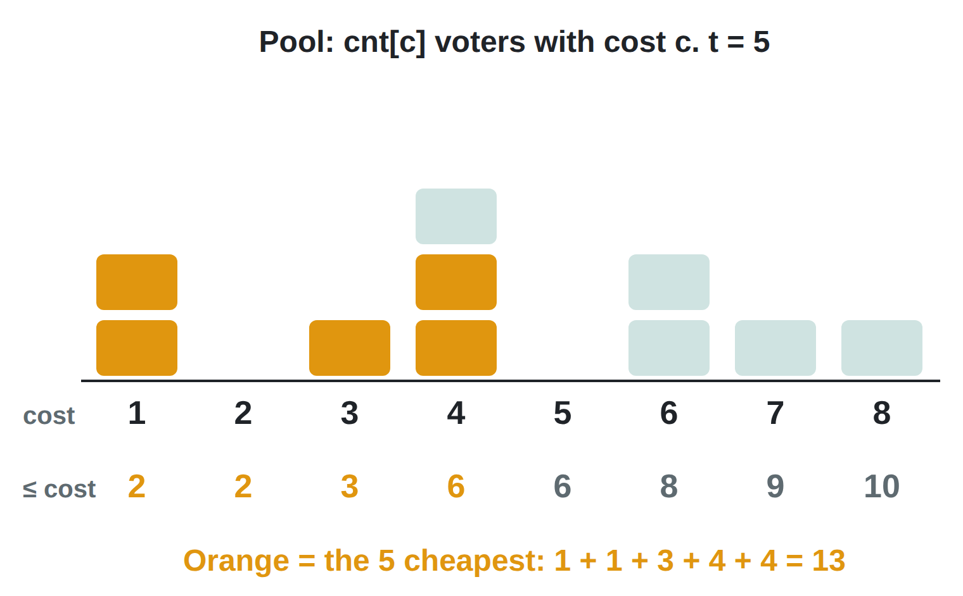
EXTRA READING · FENWICK TREE
THE TOP-UP IS A PREFIX-SUM QUESTION
Store the pool as a count array over cost: cnt[c] = voters left with cost c.
The $t$ cheapest = walk the prefix counts until they reach $t$.
The pool keeps changing (forced buys remove voters), so we need two fast operations: change one cnt[c], and walk the prefix sums.
Pool stored as | Change cnt[c] | $t$ cheapest
Plain array | $$O\left(1\right)$$ | $$O\left(C\right)$$
Blocks of 100 (lesson) | $$O\left(1\right)$$ | $$O\left(\sqrt{C}\right)$$
Fenwick tree | $$O\left(logC\right)$$ | $$O\left(logC\right)$$
$C$ = number of different costs (10 001 here).
Notes:
课外读物：用 Fenwick tree（树状数组，Binary Indexed Tree）实现 Wheeling and Dealing 的"补买"（top-up）。课上用的是按花费分块（每 100 个花费一块），这里介绍另一种做法，学有余力的同学看。
把池子看成一个按花费计数的数组：cnt[c] = 池子里花费为 c 的选民个数。"最便宜的 t 个之和"就是从花费小的往大走，把计数累加起来（prefix count），直到凑够 t 个。
图中例子：cnt = 2 0 1 3 0 2 1 1（花费 1 到 8），前缀计数 = 2 2 3 6 6 8 9 10。t = 5：前缀计数第一次 ≥ 5 是在花费 4，所以取花费 1 的 2 个、花费 3 的 1 个、花费 4 的 2 个，和 = 1 + 1 + 3 + 4 + 4 = 13。
难点在于池子一直在变：强制购买会把选民移出池子。所以需要两种操作都快：改一个 cnt[c]；沿前缀和走到第 t 个。
表格：普通数组改是 O(1)，但走前缀和要 O(C)；分块是 O(1) 和 O(√C)；Fenwick tree 两种操作都是 O(log C)。
提问：如果没有修改，只要一次查询，最简单的做法是什么？答案：先把池子排序，再求一次前缀和就行。Fenwick tree 的价值在于"边改边查"。

Slide 39
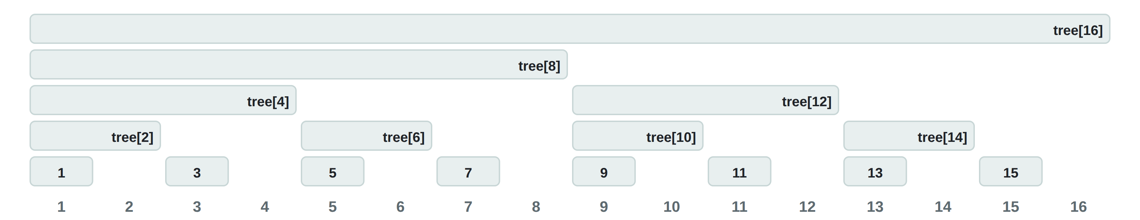
EXTRA READING · FENWICK TREE
EACH CELL STORES ONE BLOCK
lowbit(i) = i & (−i): the lowest set bit of i.
i | binary | lowbit | tree[i] covers
6 | 0110 | 2 | 5..6
7 | 0111 | 1 | 7
8 | 1000 | 8 | 1..8
12 | 1100 | 4 | 9..12
tree[i] stores the sum of cnt over the lowbit(i) positions ending at i: cnt[i − lowbit(i) + 1] + … + cnt[i].
Every prefix 1..$x$ splits into at most $logC$ of these blocks.
Notes:
Fenwick tree 的结构：一个数组 tree[1..C]，每个位置存一段连续区间的和。
lowbit(i) = i & (−i)，就是 i 的二进制里最低的那个 1 代表的数。例如 6 = 0110，lowbit = 2；12 = 1100，lowbit = 4；8 = 1000，lowbit = 8；奇数的 lowbit 都是 1。
tree[i] 存的是"以 i 结尾、长度为 lowbit(i) 的那一段"的和，即 cnt[i − lowbit(i) + 1] + … + cnt[i]。图中每个色块就是一个 tree[i] 管的范围：奇数位置只管自己，tree[2] 管 1..2，tree[4] 管 1..4，tree[8] 管 1..8，tree[12] 管 9..12，以此类推。
关键性质：任何前缀 1..x 都能拆成不超过 log C 个这样的块。例如 1..13 = tree[8]（1..8）+ tree[12]（9..12）+ tree[13]（13）。
为什么 i & (−i) 能取出最低位的 1：在补码里 −i = ~i + 1，最低位 1 以下全变成 0、以上全部取反，与 i 按位与之后只剩那一位。
提问：tree[10] 管哪一段？答案：10 = 1010，lowbit = 2，管 9..10。

Slide 40
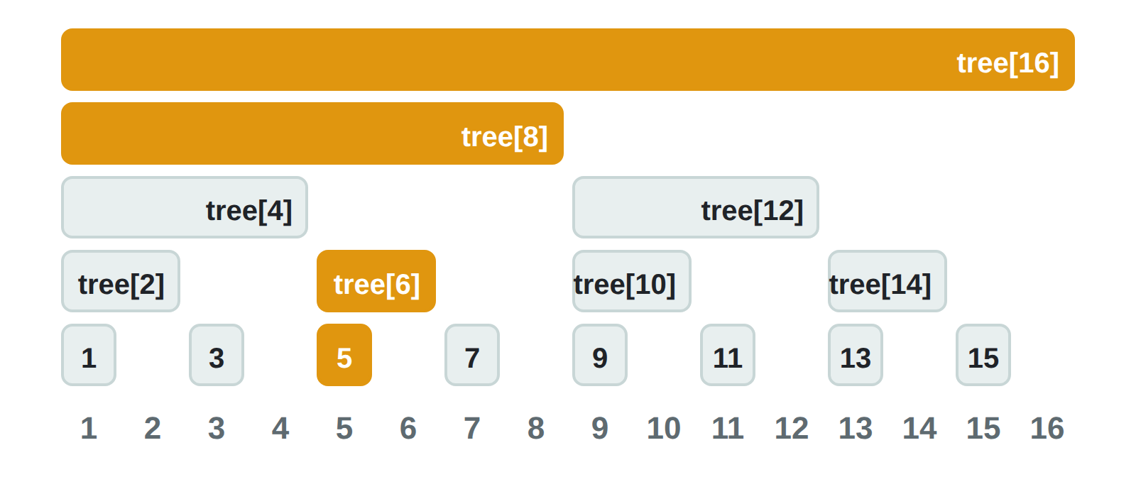
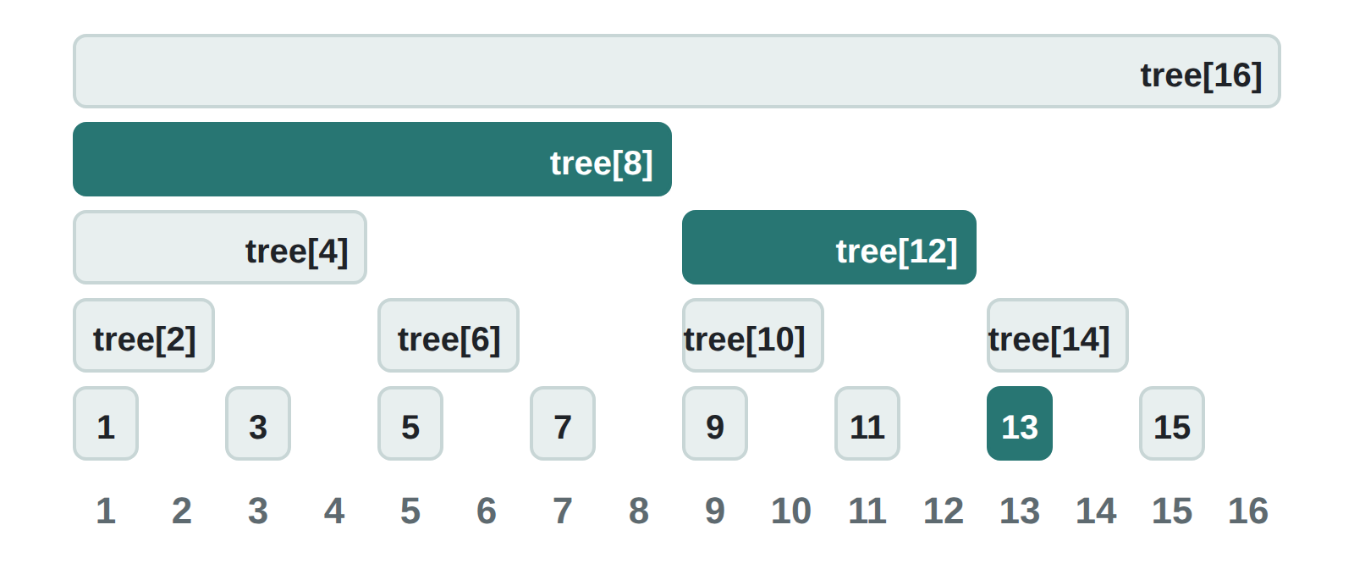
EXTRA READING · FENWICK TREE
UPDATE AND PREFIX SUM: JUMP BY LOWBIT
Change cnt[5]: go up, i += lowbit(i)
Sum of cnt[1..13]: go down, i −= lowbit(i)
5 → 6 → 8 → 16: every block that contains 5.
13 → 12 → 8: blocks 13, 9..12, 1..8 tile 1..13.
void add(int i, long long d){
for (; i <= SZ; i += i & (-i))
tree[i] += d;
}
long long ask(int i){
long long s = 0;
for (; i > 0; i -= i & (-i))
s += tree[i];
return s;
}
Each jump clears or carries one bit, so both loops take at most $logC$ steps.
Notes:
两个基本操作，都是沿着 lowbit 跳。
修改 cnt[5]（加 d）：所有"管到 5"的块都要加 d。从 i = 5 开始，每次 i += lowbit(i)：5 → 6 → 8 → 16。对照左图，橙色的块正好是包含位置 5 的所有块。
求前缀和 cnt[1..13]：从 i = 13 开始，每次 i −= lowbit(i)：13 → 12 → 8 → 0。对照右图，tree[13]（13）、tree[12]（9..12）、tree[8]（1..8）正好拼成 1..13。
为什么是 O(log C)：往下跳每次去掉最低位的 1，最多 log C 次；往上跳每次最低位的 1 往高位进，最多也是 log C 次。
代码只有几行，背下来即可。注意下标从 1 开始（下标 0 会让 i & (−i) = 0，死循环）。
练习：写出修改 cnt[3] 时经过的下标（3 → 4 → 8 → 16），以及求 cnt[1..11] 时经过的下标（11 → 10 → 8）。

Slide 41
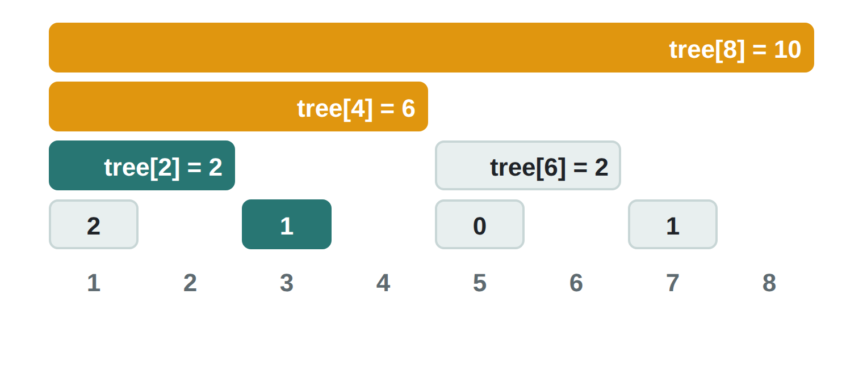
EXTRA READING · FENWICK TREE
FIND THE $t$ CHEAPEST: WALK DOWN
Start at $pos=0$. Try jumps of $2^{k}$, largest first. If the block tree[pos + $2^{k}$] holds fewer than $t$ voters, take it whole.
try | cell | covers | count | decision | pos | sum
$$k=3$$ | tree[8] | 1..8 | 10 | $10≥5$: no | — | —
$$k=2$$ | tree[4] | 1..4 | 6 | $6≥5$: no | — | —
$$k=1$$ | tree[2] | 1..2 | 2 | $2<5$: take | 2, $t=3$ | 2
$$k=0$$ | tree[3] | 3 | 1 | $1<3$: take | 3, $t=2$ | 5
Orange: tried, too many. Teal: taken whole. Small cells show tree[1], tree[3], tree[5], tree[7].
Costs 1..3 hold fewer than 5, so the last $t=2$ all cost $pos+1=4$: total = $5+2×4=$ 13 ✓
cnt = 2 0 1 3 0 2 1 1 (costs 1..8), $t=5$
Like binary search on the answer, but each probe reads one cell: $O\left(logC\right)$, no extra log.
Notes:
找"最便宜的 t 个之和"：在 Fenwick tree 上从高位往低位走（也叫 Fenwick 上的二分 / binary lifting）。
做法：pos 从 0 开始。依次尝试步长 2^k（k 从大到小）。如果 tree[pos + 2^k] 这一块里的选民数 < t，说明这一整块都要买：pos 跳过去，t 减去这一块的个数，sum 加上这一块的花费和。否则不跳（这一块太多了，答案在这一块里面）。
为什么只看一个格子就够：pos 每次都是 2 的幂之和，pos + 2^k 的 lowbit 正好是 2^k，所以 tree[pos + 2^k] 管的恰好是 pos+1 .. pos+2^k 这一段，就是"接下来的 2^k 个花费"。
例子（cnt = 2 0 1 3 0 2 1 1，t = 5）：
k = 3：tree[8] 管 1..8，有 10 个 ≥ 5，不跳。
k = 2：tree[4] 管 1..4，有 6 个 ≥ 5，不跳。
k = 1：tree[2] 管 1..2，有 2 个 < 5，整块买下：pos = 2，t = 3，sum = 2（两个花费 1）。
k = 0：tree[3] 管 3，有 1 个 < 3，买下：pos = 3，t = 2，sum = 2 + 3 = 5。
结束时花费 1..pos 一共不到 t 个，剩下的 t = 2 个都在花费 pos + 1 = 4：总和 = 5 + 2 × 4 = 13，和第一页的答案一样。
要点：需要两棵 Fenwick tree，一棵存个数（决定跳不跳），一棵存花费和（跳的时候累加）。复杂度 O(log C)。如果改用"二分花费 + 每次 ask 前缀和"也可以，但是 O(log² C)。
注意数组大小要取 2 的幂（代码里取 2^14 = 16384 > 10001），这样从最高位开始走才不会越界。

Slide 42
EXTRA READING · FENWICK TREE
THE TOP-UP IN C++
const int LOG = 14, SZ = 1 << LOG; // 16384 > 10001
long long fcnt[SZ + 1], fsum[SZ + 1];
// add (d = 1) or remove (d = -1) a voter of cost c
void add(int c, int d){
for (int i = c + 1; i <= SZ; i += i & (-i)){
fcnt[i] += d;
fsum[i] += d * c;
}
}
// sum of the t cheapest voters (t <= pool)
long long cheapest(long long t){
int pos = 0;
long long sum = 0;
for (int k = LOG; k >= 0; k --){
int nxt = pos + (1 << k);
if (nxt <= SZ && fcnt[nxt] < t){
pos = nxt;
t -= fcnt[nxt];
sum += fsum[nxt];
}
}
return sum + t * pos; // the rest cost pos
}
Two trees. fcnt counts voters, fsum adds up their costs. Both change together.
Index = cost + 1. A cost can be 0, and index 0 would loop forever. So after the walk, index $pos+1$ means cost $pos$.
Drop-in swap. add() and cheapest() replace the bucket version; the sweep over $k$ stays the same.
Full program: Code/2023_P5_Wheeling_and_Dealing_Fenwick.cpp (checked against the bucket version on 3000 random tests).
Notes:
完整的 Fenwick 版补买代码，两个函数可以直接替换课上分块版的 add() 和 cheapest()，主程序（k 从大到小扫、强制购买）完全不用改。
fcnt 存个数、fsum 存花费和，两棵树同时更新。
下标 = 花费 + 1：花费可能是 0，而下标 0 在 Fenwick 里不能用（i & (−i) = 0，循环不会动）。所以花费 c 放在下标 c + 1。走完之后，下标 1..pos 对应花费 0..pos − 1，剩下的 t 个都在下标 pos + 1，也就是花费 pos，所以最后加 t * pos。（上一页的例子花费从 1 开始、没有平移，所以那里写的是 pos + 1。）
数组大小取 2^14 = 16384，比 10001 个可能的花费大，而且是 2 的幂，从 k = LOG 开始走不会漏也不会越界。
调用前要保证 t ≤ 池子里的人数（主程序里已经判断 k − have > pool 时跳过）。
完整程序在 Code 文件夹：2023_P5_Wheeling_and_Dealing_Fenwick.cpp，已经和分块版用 3000 组随机数据比对过，结果一致。

Slide 43
EXTRA READING · FENWICK TREE
BLOCKS OR FENWICK?
Top-up with | Change one cost | $t$ cheapest | All $k$ ($M={10}^{5}$)
Blocks of 100 | $$O\left(1\right)$$ | $O\left(\sqrt{C}\right)≈200$ steps | $≈2×{10}^{7}$ ✓
Fenwick tree | $$O\left(logC\right)≈14$$ | $O\left(logC\right)≈15$ steps | $≈3×{10}^{6}$ ✓
Blocks
Fenwick tree
No new idea, easy to get right. Needs a small value range (here costs $≤10000$).
A tool you will reuse: prefix sums that change, the $k$-th smallest in a changing set, counting inversions.
Both pass here. In a contest, write the one you can write without bugs.
Try it: count the pairs $i<j$ with $A_{i}>A_{j}$ (inversions) using add() and ask().
Notes:
两种做法对比：分块每次补买约 200 步（O(√C)），Fenwick 约 15 步（O(log C)），但 Fenwick 每次修改也要 O(log C)。对 M = 10^5，分块总共约 2 × 10^7，Fenwick 约 3 × 10^6，都能轻松通过。
分块的优点：不用学新东西，不容易写错；缺点：要求值域小（这里花费 ≤ 10000）。
Fenwick tree 的优点：以后会反复用到。"会变的前缀和"、"动态集合里的第 k 小"、"逆序对计数"都是它的经典用法；AIIO 及以上的题目经常需要。
比赛建议：两种都能过时，写你最有把握一次写对的那种。
练习（答案）：逆序对计数。从左往右扫，对每个 A[j]，先用 ask 查已经出现的数里有多少个 ≤ A[j]，用已出现的个数 j − 1 减去它，就是以 j 结尾的逆序对数；然后 add(A[j], 1)。值域大时先离散化（排序后换成名次）。复杂度 O(N log N)。

